Slide 1
Simple machines
Egyszerű gépek

Slide 2
https://www.youtube.com/watch?v=cXioskE2N8s

Slide 3
Simple machines
Throughout the history, humans have developed several devices to make work easier
The most notable of these are known as simple machines

Slide 4
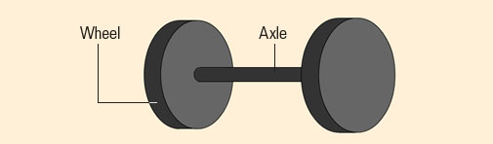
Wheel and axle
The wheel is considered to be one of the most significant inventions in the history of the world
The wheel greatly reduces the friction encountered when an object is moved over a surface

Slide 5
Force multipliers
This machines help humans increase the force applied to an object

Slide 6
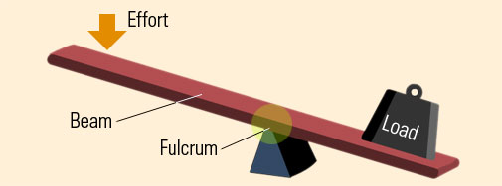
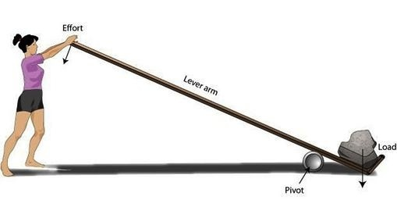
Lever -Emelő
A lever consists of a long beam and a fulcrum, or pivot

Slide 7
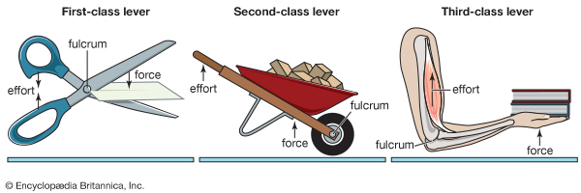
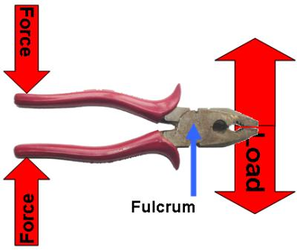
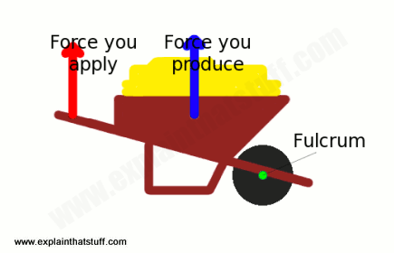
Lever - Emelő
Scissors, pliers: first class lever
The fulcrum is between the effort and the resistance
Kétkarú emelő
Wheelbarrow: second class lever
The resistance is between the fulcrum and effort
Egykarú emelő

Slide 8
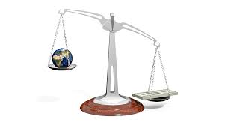
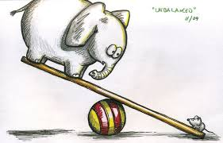
Lever

Slide 9
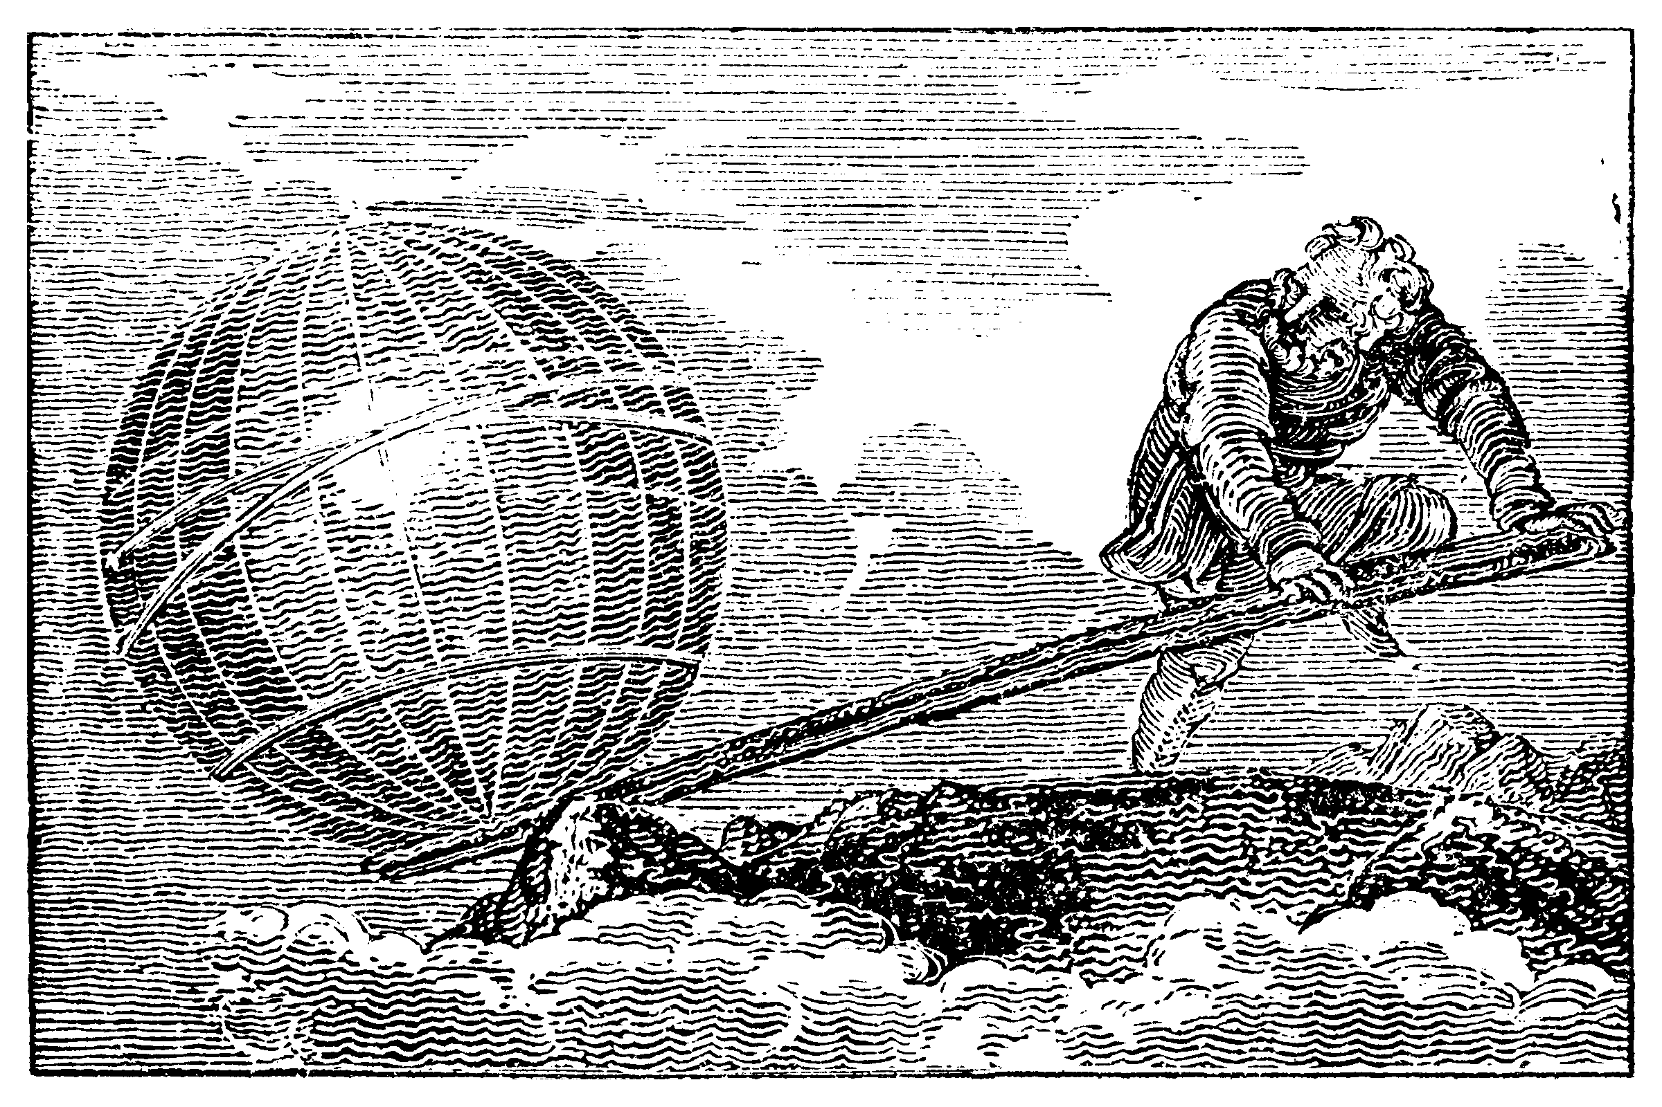
Lever
“Give me a lever and a place to stand, and I’ll move the world.”
“Adjatok egy fix pontot és kiforgatom sarkaiból a világot”
Archimedes 287-212 BC
While it may be a bit exaggeration, it does express the power of leverage

Slide 10
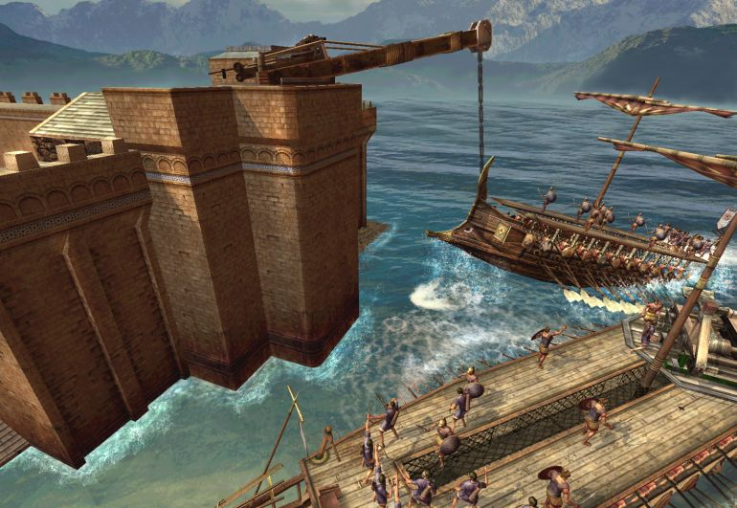
Lever – Archimedes
He protected his native Syracuse from invasion with these machines
The Claw of Archimedes

Slide 11
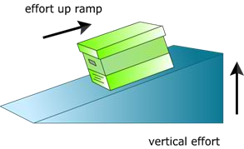
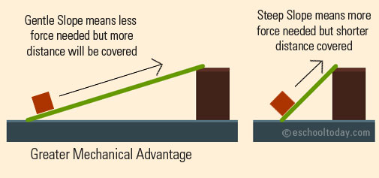
Inclined plane - Lejtő
It is a way of lifting a load
You need less force to lift the load on an inclined plane
Steeper ramp: more force is required
Gentler ramp: less force is required

Slide 12
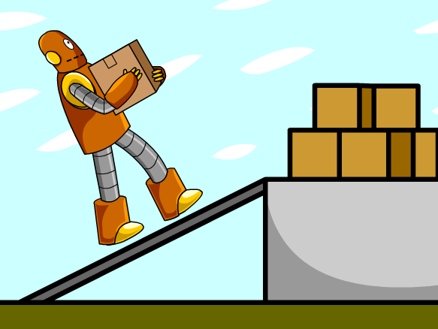
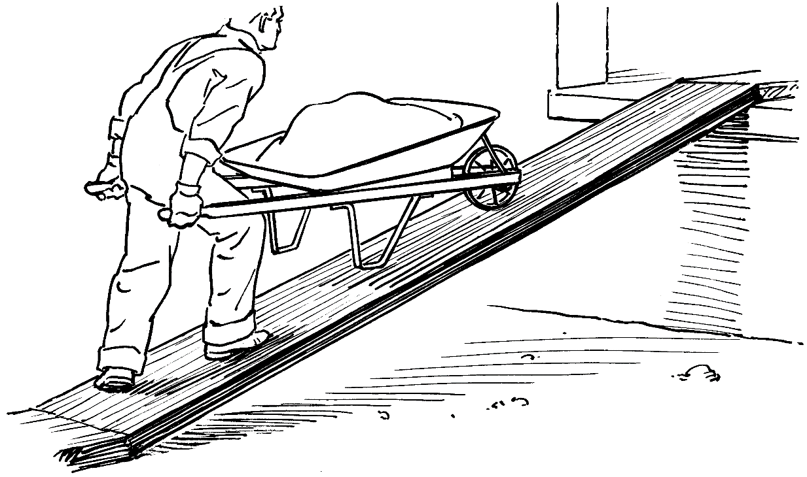
Inclined plane

Slide 13
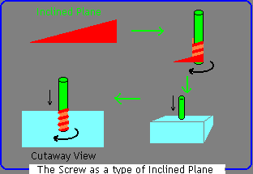
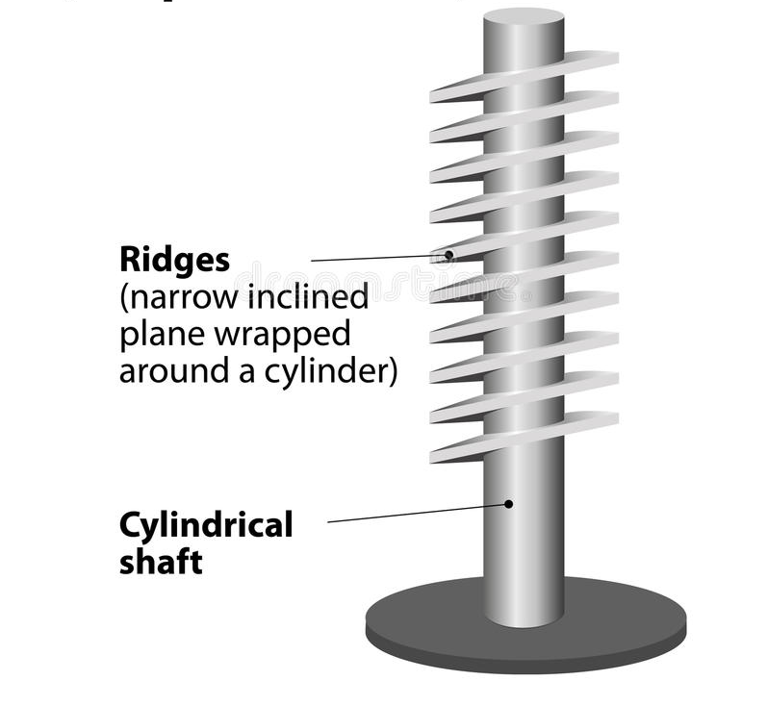
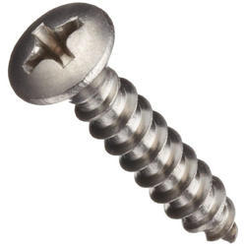
Screw - Csavar
It is a long inclined plane wrapped around a shaft
You can exert a force that is much greater than the force used to turn the screw

Slide 14
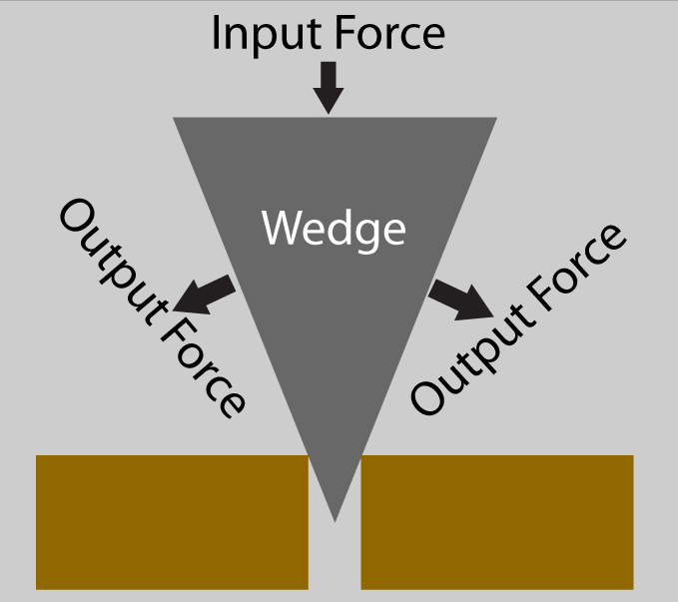
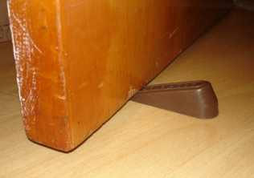
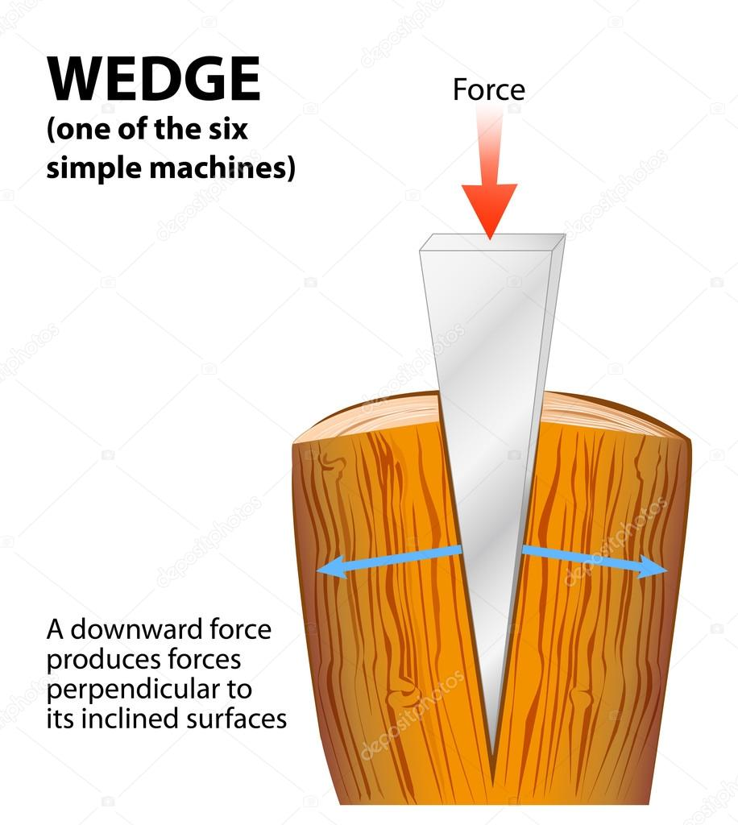
Wedge - Ék
Wedges are moving inclined planes that are driven under loads to lift, or to split or separate
A longer, thinner wedge gives more mechanical advantage than a shorter, wider wedge
The main function of a wedge is to change the direction of the input force

Slide 15
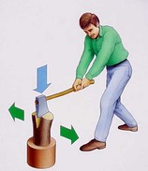
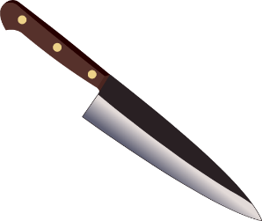
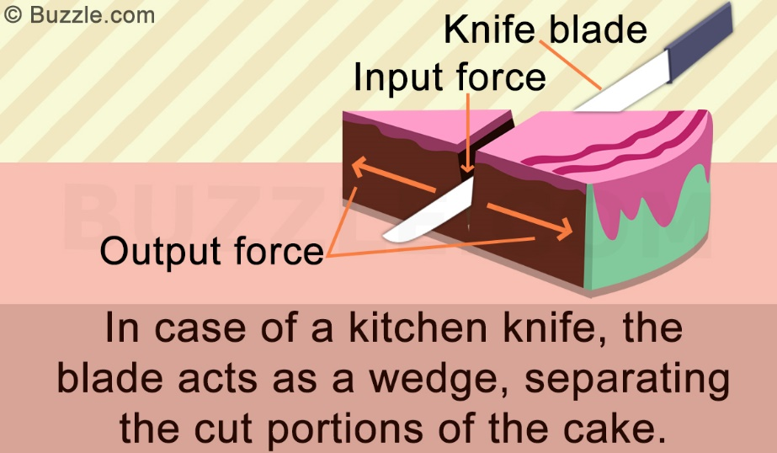
Wedge

Slide 16
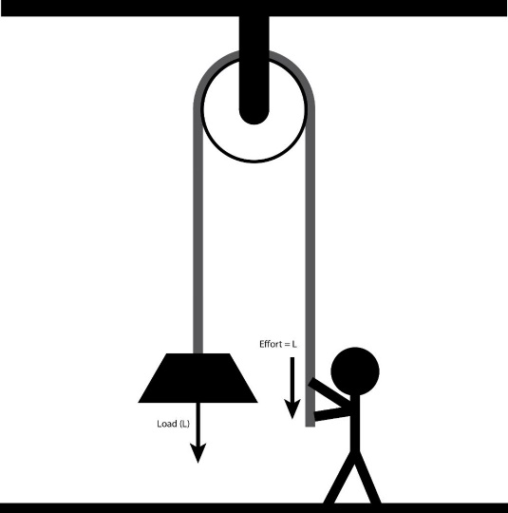
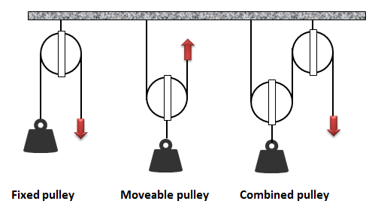
Pulley
If we want to lift an object
Fixed pulley – Állócsiga
It is a wheel hanging from a beam. A rope is draped over the wheel and one end is attached to the object to be lifted. The other end is pulled down to lift the object
A fixed pulley remains in the same place
It requires the same force
It changes the direction of the force
The pulley let us pull down the object instead of up on the rope

Slide 17
Pulley
Movable pulley -Mozgócsiga
It is attached to the weight
It is hung in such way that it moves when you lift the object
It doesn’t change the direction of the force
It reduces the magnitude of the force by half

Slide 18
Pulley
Combined pulley -Csigapár
It’s a combination of a fixed and a movable pulley
It changes the direction of the force
It reduces the magnitude of the force by half

Slide 19
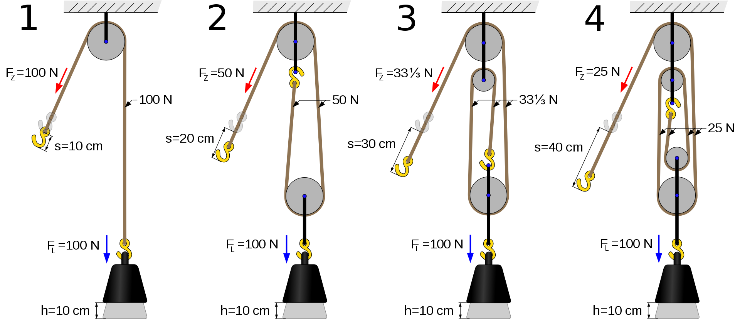
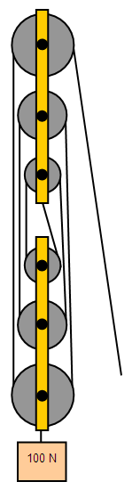
Pulley
Pulley system - Csigasor
Two or more pairs of fixed and movable pulley
Two pairs: The force is going to be the quarter of the original force
Three pairs: The force is going to be the eighth of the original force

